Slide 1


Introduction to Nutrition
Fruitful Minds
Piedmont Middle School

Slide 2

What is nutrition?
  What is in our food
  How food affects your body
How do YOU choose the foods you eat?
appetite
allergies
family
tastes good
tradition
culture
Notes:
Ask kids what they think nutrition is? What have they learned about it and from where?
Some possible answers for how we choose the foods we eat - appetite, taste, good for us, tradition, culture

Slide 3


Why should you care?
  YOU can make choices for your health
  Choosing the right foods is a big step in the right direction!
  Base your choices on what YOU like AND what you know is good for you
You have the power!
Notes:
End of class: inspirational “I have the power”

Slide 4
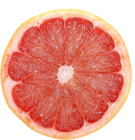

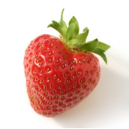
Food Groups
Putting food into groups helps us make healthy choices:
  Grains
  Vegetables
  Fruit
  Dairy
  Meat & Beans
  Oils

Slide 5
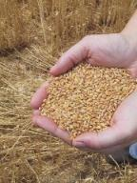
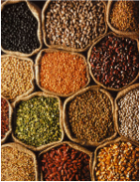

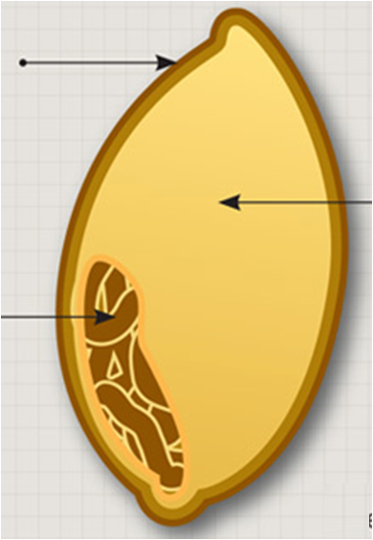

Grains
5-8 servings
Whole
  Entire grain kernel
    Whole-wheat flour, oatmeal, whole cornmeal, brown rice
Refined
  Milled grains
    White flour, white bread, white rice
bran
endosperm
germ
TIP: if you don’t like whole grain pasta , try mixing whole grain pasta with refined pasta
Notes:
Bran is fiber rich outer layer
Endosperm
Germ is nutrient rich inner part
Try substituting whole grains for refined

Slide 6
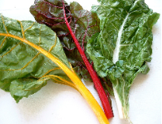
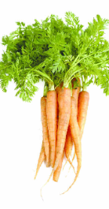

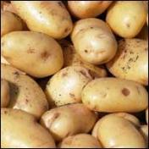



Vegetables
Goal: eat 2-3 servings a day!
(1 servings = size of fist)
Orange Vegetables
  carrots
  sweet potato
Dark green
vegetables
  spinach
  broccoli
  lettuce
Starchy vegetables
  potatoes
  green peas
  corn
Other
  celery
  tomato

Slide 7
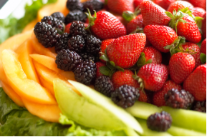




Fruit
2-3 servings
  Eat a variety
  Eat whole fruits
  Eat what's in season
Try a smoothie:
1 yogurt
1 banana
1 cup orange juice
1/2 bag frozen berries
  Don’t forget fiber!
  Choose whole fruits
  over juice
Notes:
Fruit & vegetables: good source of vitamins
Don’t forget the fiber: while fruit juice does count towards your daily fruit intake, it lacks the fiber that whole fruit provides, and has added sugar
Fruit is naturally sweet, and therefore makes a good dessert

Slide 8

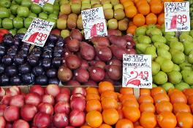
Where can I find fruits & vegetables?
  Fresh
    look at Farmer’s Market
    look in season
    community gardens
  Frozen
  Dried
Each source is nutritious
  Frozen and canned are processed right after harvest
  This preserves nutritional value & flavor
Notes:
Talk about the Fruitvale Farmers Market: 1-3pm Sundays, year-round
Best in season bc of taste, cost, and can eat locally

Slide 9
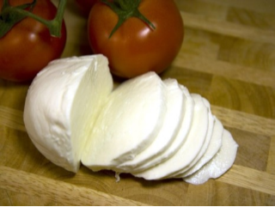

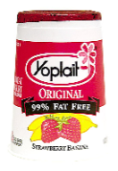
Dairy
  3 servings/day
  Choose low-fat
  Calcium = strong bones
Skim milk
yogurt
Mozzarella cheese
Notes:
Important at your age when growing

Slide 10


Meat & Beans
Go Lean!
  meat, poultry, fish, dry beans, eggs, nuts, seeds, hummus, nut butters
  Go lean! It is healthier for your heart
  Fish, nuts, seeds contain oils (called omega acids) that are good for your heart
Recommended: 2 servings per day

Slide 11








What is a serving size?
Remember: Eat 2-3 servings fruit, 2-3 servings vegetables a day
1 serving fruit or vegetables = size of fist
1/2 serving= rounded handful
1/2 cup
1 cup
1 container of apple sauce
1 small wedge
of cantaloupe
1 small apple
1 small banana
1 small grapefruit
Notes:
Note 1 cup dried fruit = 1/2 cup fruit equivalent
Also 1 cup cooked spinach = 1/2 cup vegetable equivalent

Slide 12

What is the Pyramid illustrating?
  Every color every day
  Match the amount to the width of the band
  Choose healthier foods in a group

Slide 13




Treats to limit
  Solid fats: butter & shortening
  High sugar foods
Look out for packaged foods & snacks:
Know they have fewer nutrients, but taste good!
Have the treat in moderation but ALSO give your body the good stuff it needs!

Slide 14

Now is the time for you to decide!
How will you decide to
become a healthier you?
  Know the food groups
  Eat a balanced diet
  Eat in season
  Eat a variety
  2 cups fruit and 3 veggies a day
  Whole foods instead of juice, packaged or processed
  Don't forget to move your body -

Slide 15
FOODS KIDS LIKE
Grains: oatmeal, white rice, brown rice, barley, popcorn, crackers, pasta, white bread, brown bread, tortillas, cornbread, noodles, grits, pita bread, pretzels, cereal, biscuits, corn chips, pancakes, waffles, bagels, scones, muffins, sushi, tapioca, crackers
Vegetables: broccoli, spinach, carrots, pumpkin, black beans, tofu, corn, green peas, celery, mushrooms, tomatoes, kale, cabbage, green beans, zucchini, peppers, avocado, salsa, onions, artichoke, cauliflower, spinach, lettuce, asparagus, bok choi, nori (sea weed), cucumbers, beets, eggplant, onions, potatoes
Fruits: Apples, apricots, avocado, bananas, strawberries, blueberries, raspberries, cherries, mango, watermelon, oranges, peaches, pineapple, plums, tangerines, blackberries, pomegranate, guava, cherries, kiwi, grapefruit, grapes
Meats/beans: beef, ham, chicken, turkey, eggs , tuna, crabs, shrimp, pecans, lobster, lamb, veal, almonds, peanuts, walnuts, cashews, pistachios, hummus, squid, bacon, rib, pork chops, chestnuts, sausage, black beans, pinto beans, kidney beans, fish
Dairy: ice cream, yogurt, sour cream, milk, cheese, cream cheese, cottage cheese, milkshake

